Slide 2
Patterns in the Number of Texans with New HIV Diagnoses and Living with Diagnosed HIV in 2019
HIV/STD Epidemiology and Surveillance Branch
Prepared in March 2020

Slide 3
About These Data
The information in these slides is drawn from routine disease surveillance systems for HIV unless otherwise noted.
The comprehensive HIV prevention and care plan – HIV in Texas – is the implementation road map for ending HIV. This plan names five priority populations:
  Hispanic/Latinx gay and bisexual men and other men who have sex with men (MSM)
  Black MSM
  White MSM
  Black women who have sex with men
  Transgender people
For more information, please visit https://www.dshs.texas.gov/hivstd/reports/
3

Slide 4
Acronyms
AIDS = Acquired Immunodeficiency Syndrome
HIV = Human Immunodeficiency Virus
PLWH = People living with HIV
EMA = Eligible Metropolitan Area
TGA = Transitional Grant Area
MSM = Gay and bisexual men and other men who have sex with men
IDU = Injection drug use
ICE = Immigration and Customs Enforcement
TDCJ = Texas Department of Criminal Justice
4

Slide 5
People with New HIV Diagnoses, PLWH, and Deaths from All Causes among PLWH in Texas (1981-2019)
*There is a two-year lag in availability of complete death data
Notes:
Effective treatment has extended the lifespans of people living with HIV (PLWH). As more persons living with HIV live longer, the number of PLWH continues to increase as additional persons are diagnosed.

Slide 6
Deaths related to HIV among PLWH in Texas (1999-2017)
*There is a two-year lag in availability of complete death data
Notes:
HIV/AIDS-related deaths have continuously declined in the past 20 years.

Slide 7
Texans with New Diagnoses in 2019
The number of people with new HIV diagnoses have slightly decreased from 4,482 in 2010 to 4,203 in 2019. Rates dropped more dramatically, from 17.8/100,000 to 14.5/100,000.
In 2019, the number and rate of new HIV diagnoses were highest among: males (N=3,440; rate: 23.9/100,000), Blacks (N=1,498; rate=42.8/100K), Hispanic/Latinx (N=1,698; rate=14.7/100K), and those 25-29 years of age (N=892; rate=41.1/100K).
When someone is diagnosed with AIDS within three months of their HIV diagnosis, they have a late diagnosis. The percentage of people diagnosed in a year with a late diagnosis declined from 29% in 2010 to 20% in 2019.
Over half of the people with new HIV diagnoses live in areas of high poverty, lower education, and high unemployment.

Slide 8
People with New Diagnoses and Rates by Year of Diagnosis, 2010-2019
Notes:
The annual number of newly diagnosed HIV infections has remained constant for the last 10 years with a slight decrease in the rate of new diagnoses.

Slide 9
People with New Diagnoses by Sex at Birth and Year of Diagnosis, 2010-2019

Slide 10
New HIV Diagnoses Rates by Sex at Birth and Year of Diagnosis, 2010-2019
Notes:
The rate of new HIV diagnosis for males is nearly 5 times higher for males compared to females.

Slide 11
People with New HIV Diagnoses by Race/Ethnicity and Year of Diagnosis, 2010-2019

Slide 12
New HIV Diagnoses Rates by Race/Ethnicity and Year of Diagnosis, 2010-2019
Notes:
Racial disparities in the rate of new HIV diagnoses persist despite the noteworthy decline in the rate of new HIV diagnoses among Black Texans.

Slide 13
People with New HIV Diagnoses by Age at Diagnosis, 2019
*
*Note: There were no new HIV diagnoses among 10-14 year old age groups in 2019.

Slide 14
New HIV Diagnoses Rates by Age at Diagnosis, 2019
*
*Note: There were no new HIV diagnoses among 10-14 year olds in 2019.
Notes:
The higher rates of new HIV diagnosis are among those aged under 40, with 25-29 year-olds having the highest rates.

Slide 15
New HIV Diagnoses Rates Among People Aged 15-34,
2010-2019
Notes:
The majority of persons newly diagnosed with HIV are between the ages of 15-34. Those 20-29 have the highest rates of new diagnosis.

Slide 16
Late Diagnoses* as Percentage of Total HIV Diagnoses, 2011-2019
* Stage 3 (AIDS) diagnosis within 3 months of HIV diagnosis diagnosis
Notes:
The percent of late diagnoses has steadily decreased in the past 10 years.

Slide 17
Late Diagnoses* as Percent of Total HIV Diagnoses by EMA/TGA**, 2019
* Stage 3 (AIDS) diagnosis within 3 months of HIV diagnosis
**Eligible Metropolitan Areas (EMAs) and Transitional Grant Areas (TGAs) are metropolitan areas consisting of several counties designated by the Ryan White HIV/AIDS Program for funding purposes
Notes:
The U.S.-Mexico border region has the highest percent of late diagnosis.

Slide 18
People with New HIV Diagnoses by Mode of Transmission Group*, 2010-2019
* Mode of transmission is imputed when risk information is missing
Notes:
Over 70% of new HIV diagnoses were among MSM. This explains the large rate of HIV diagnosis disparity between Males and Females displayed in slide 11.

Slide 19
People with New HIV Diagnoses by Mode of Transmission and Sex at Birth, 2019
N=763
N=3,440
Notes:
The primary mode of transmission for Males and Females is sexual contact, with MSM representing 85% of new diagnoses among males and sex with males representing 83% of new diagnoses among females.

Slide 20
People with New HIV Diagnoses by Priority Population, 2010 vs. 2019
N=3,126
N=3,125
Notes:
The proportion of new HIV diagnoses among Hispanic MSM increased between 2010 and 2019.

Slide 21
New HIV Diagnoses by Mode of Transmission and EMA/TGA*, 2019
*Eligible Metropolitan Areas (EMAs) and Transitional Grant Areas (TGAs) are metropolitan areas consisting of several counties designated by the Ryan White HIV/AIDS Program for funding purposes
Notes:
The majority of new HIV diagnoses by mode of transmission is MSM across all EMA/TGAs for 2019.

Slide 22
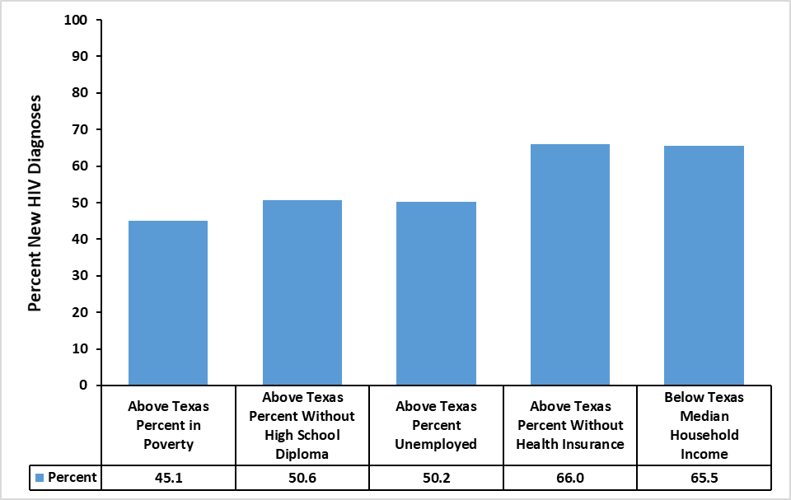
Socioeconomic Indicators in People with New HIV Diagnoses (Ages 18+ years), 2019
Notes:
Federal Poverty Level : 45.1% of the people with new HIV diagnoses lived in census tracts where the percent of the population living in poverty was above the Texas average of 14.7%.
Less than High School Education: 50.6% of the new HIV diagnoses lived in census tracts where the percent of the population 25 years and older without high school diploma was above the Texas average of 16.3%.
Unemployed: 50.2% of the new HIV diagnoses lived in census tracts where the percent of residents in the labor force and unemployed was above the Texas average of 5.1%.
Without Insurance: 66.0% of the new HIV diagnoses lived in census tracts where the percent of residents that do not have health insurance was above the Texas average of 17.2%.
Median Household Income: 65.5% of the new HIV diagnoses lived in census tracts where the median household income was below the Texas annual median household income of $61,874 in 2019 inflation-adjusted dollars.

Slide 23
People Living with Diagnosed HIV in Texas in 2019
Gay and bisexual men and other men who have sex with men (MSM) comprised over half (62%) of people living with diagnosed HIV.
By 2019, over half of PLWH were 45 years of age or older.
Between 2010 and 2019, the total number of PLWH increased by 43% and proportion of PLWH in priority populations increased by 5.6%.
A majority of people living with HIV live in urban areas of Texas. The counties with the largest numbers of PLWH were Harris and Dallas, followed by Bexar, Tarrant, and Travis.

Slide 24
People Living with Diagnosed HIV by Sex at Birth, 2019
Notes:
There are around 50,000 more males than females living with HIV.

Slide 25
People Living with Diagnosed HIV by Race/Ethnicity, 2019
Race/Ethnicity
*Native Hawaiian/Pacific Islander **American Indian/Alaskan Native
Notes:
There are more Black Texans living with HIV than any other race/ethnicity.

Slide 26
People Living with Diagnosed HIV by Age, 2019
Notes:
Due to antiretroviral therapy people are living longer with HIV. The majority of people living with HIV are over 45 years of age.

Slide 27
People Living with diagnosed HIV by Mode of Transmission Groups*, 2019
N=97,844
* Mode of transmission is imputed when risk information is missing
** Adult Other includes received clotting factor, transfusion/transplant, other and unknown
Notes:
MSM comprised the majority of PLWH.

Slide 28
HIV Prevalence by Priority Group,
2010 vs. 2019
N=68,388
N=97,844
Notes:
The proportion of PLWH who are Hispanic/Latinx and Black MSM increased from 2010 but the overall population of PLWH has not changed dramatically in the past 10 years.

Slide 29
Regional Data

Slide 30
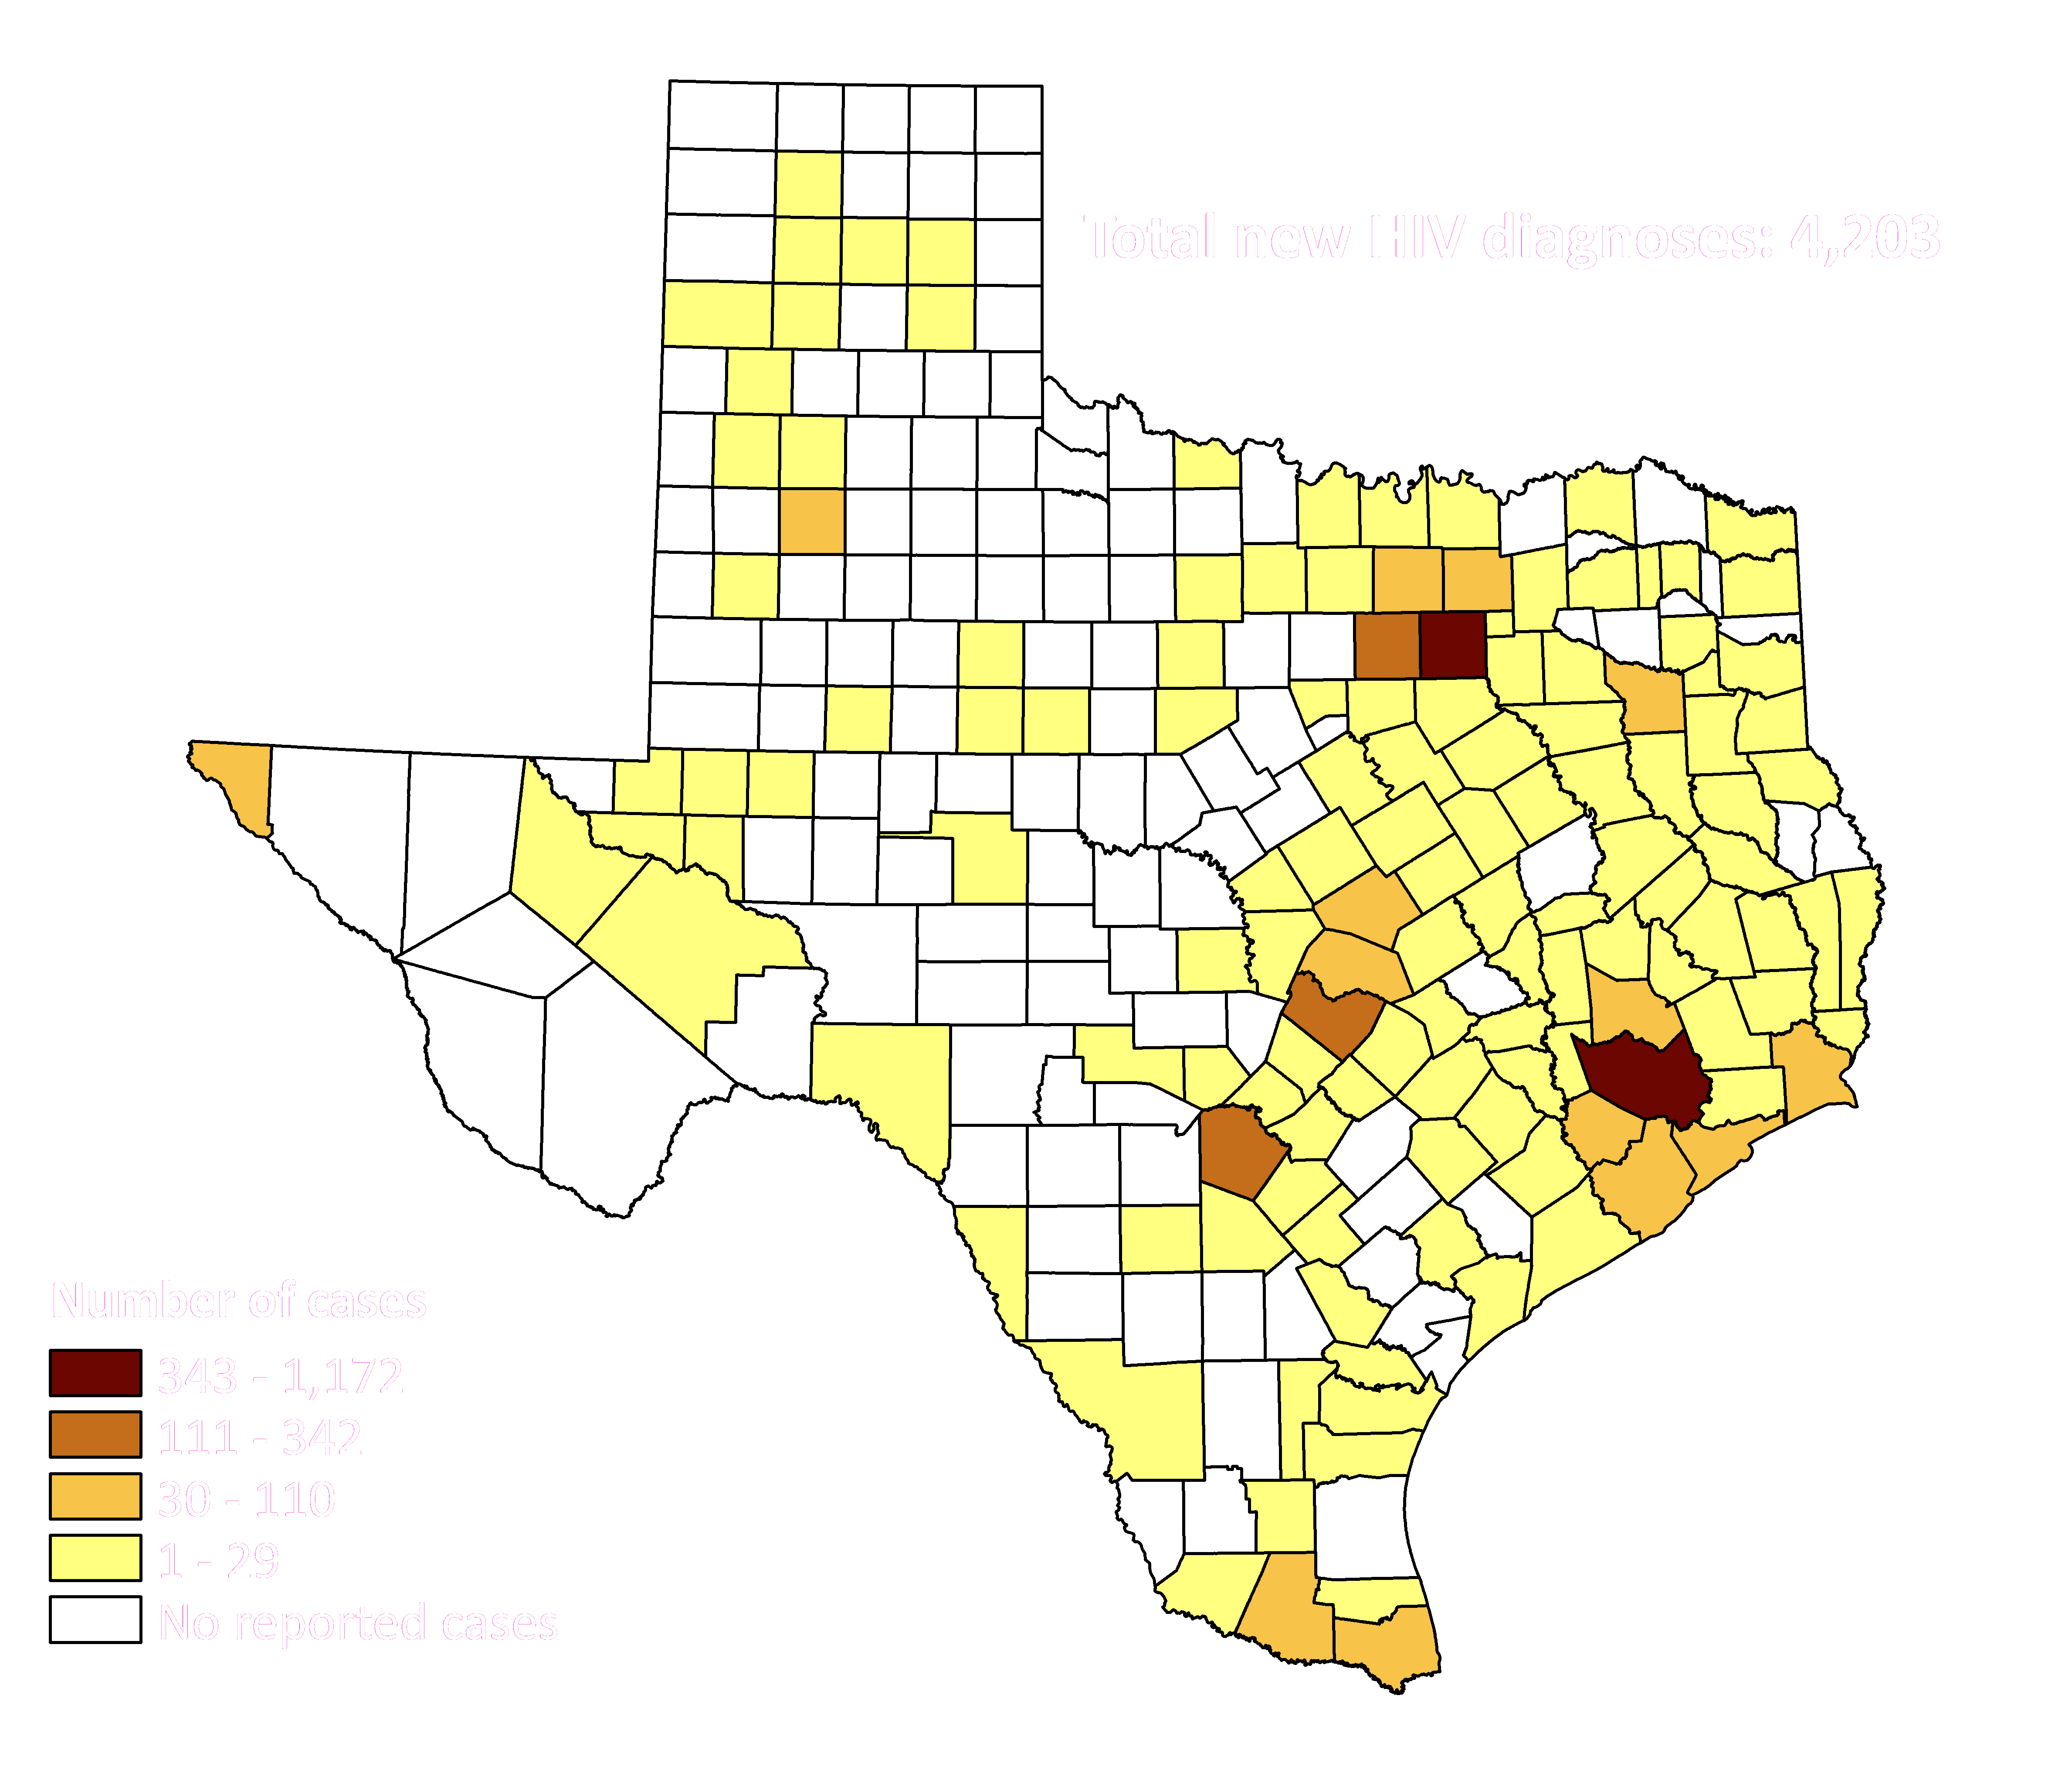
People with New HIV Diagnoses by County, 2019
Notes:
New diagnoses in Texas by county are highest among counties with the most populous cities.

Slide 31
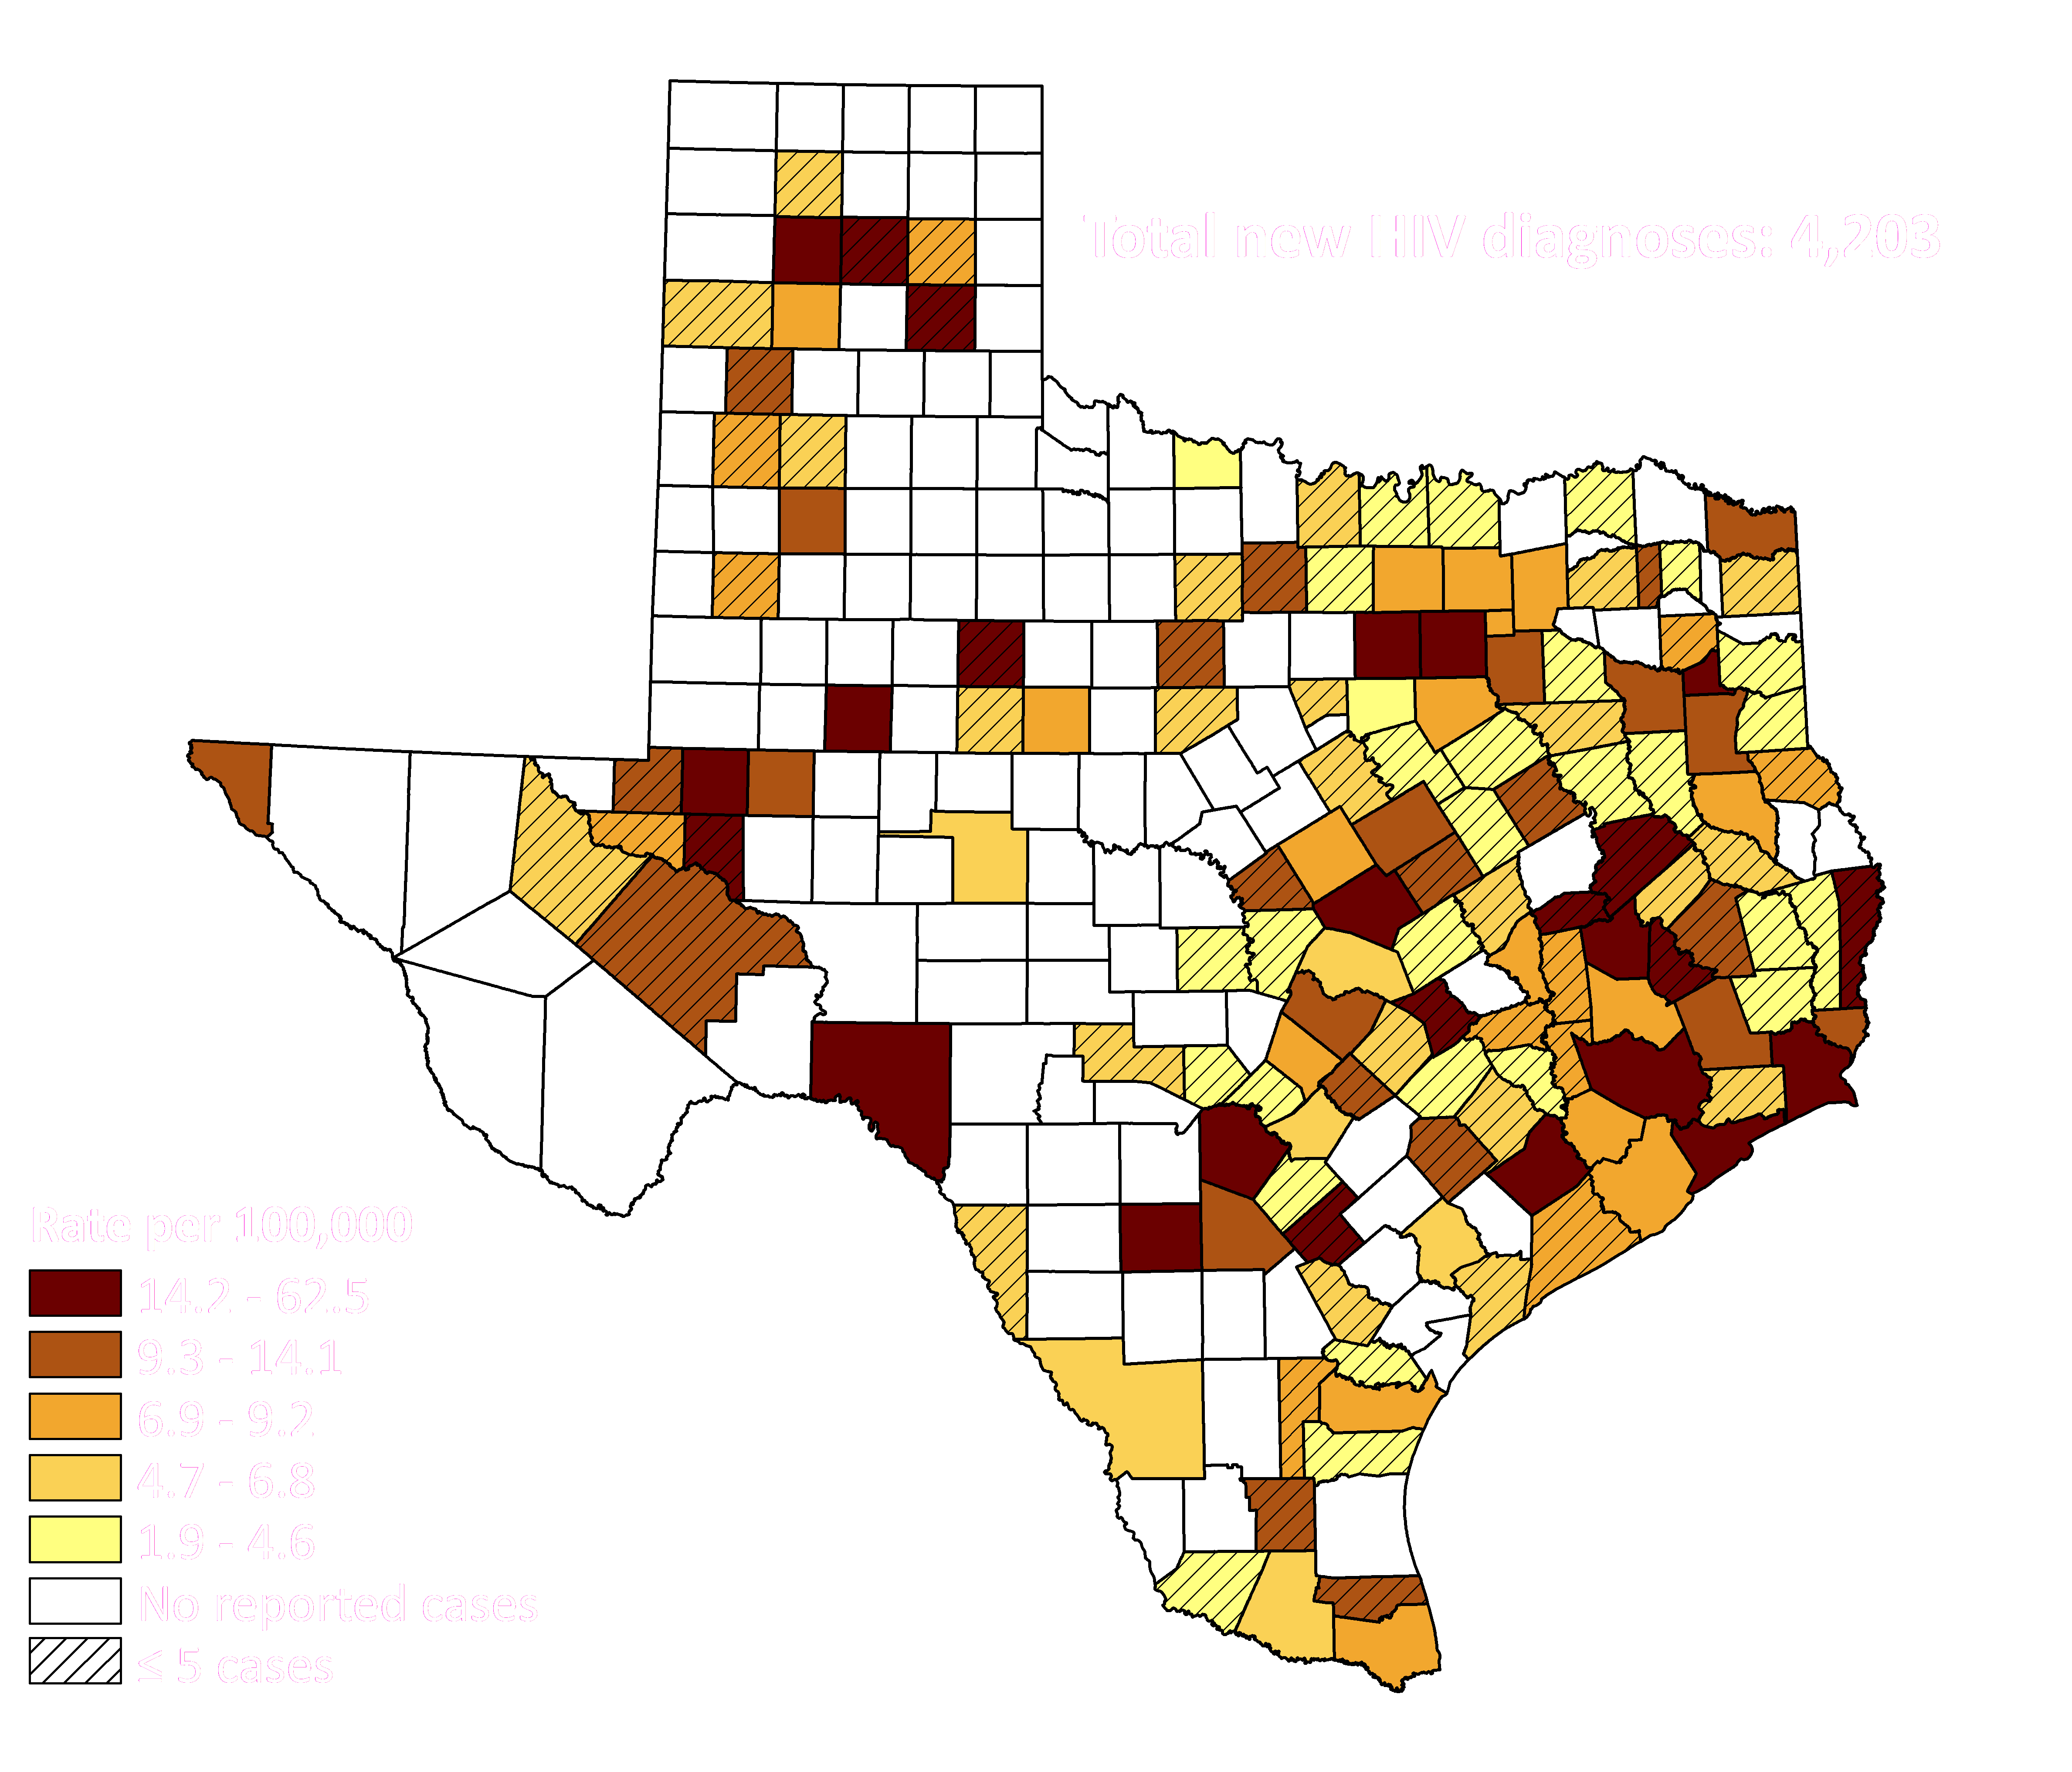
Rate of New HIV Diagnoses by Texas County, 2019
Notes:
Rates are highest along the border and east Texas.

Slide 32
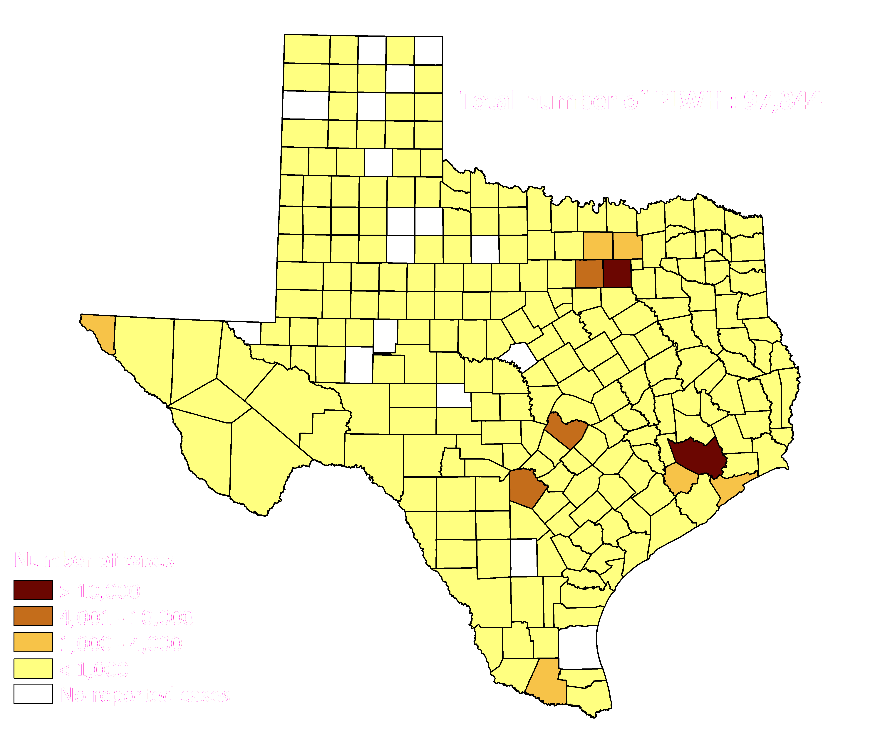
People Living with Diagnosed HIV by Texas County, 2019
Notes:
The majority of people living with HIV are in the Dallas-Fort Worth area, Houston area, San Antonio area, and Austin area.

Slide 33
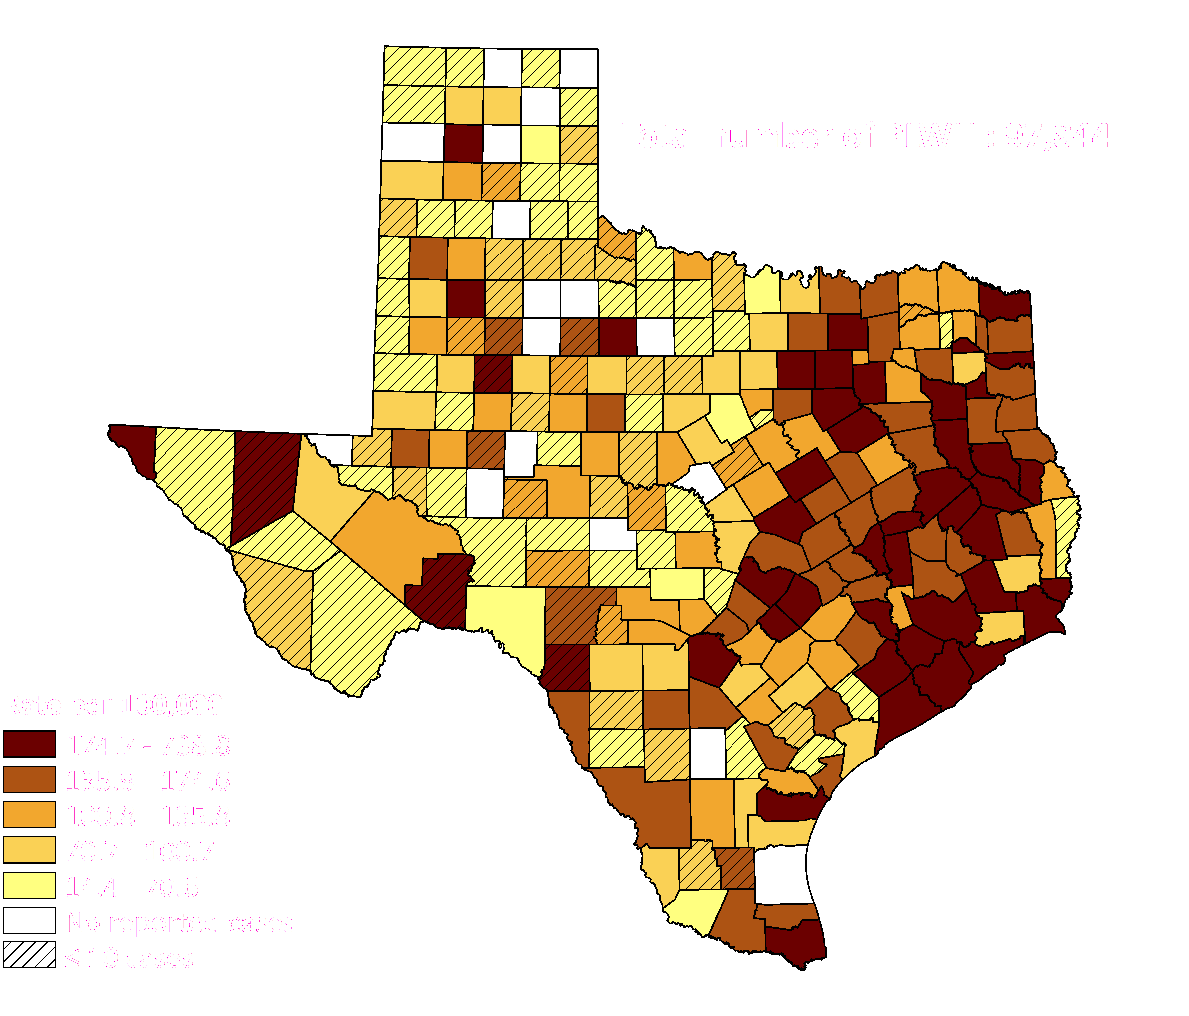
Rates of People Living with Diagnosed HIV by Texas County, 2019

Slide 34
Texas Treatment Cascade

Slide 35
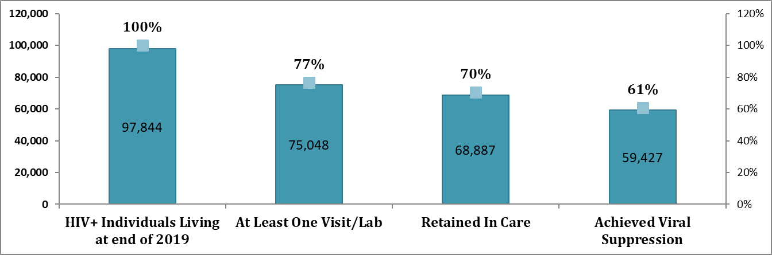
Texas Treatment Cascade, 2019
Number of Texans Living With HIV
Percentage
Notes:
Out of the 97,844 Texans living with HIV by the end of 2019, 77% had at least one doctor’s visit or labs drawn. Out of the 75,048 Texans living with HIV who had at least one visit/lab, 70% were retained in care. And finally, out of the 68,887 Texans living with HIV who were retained in care, more than half (61%) have achieved viral suppression.

Slide 36
Where to Find More Information
For more information and additional reports, please visit: https://www.dshs.texas.gov/hivstd/reports/
Please visit our data portals located on the Center for Health Statistics website:
New HIV diagnoses: http://healthdata.dshs.texas.gov/dashboard/diseases/new-hiv-diagnoses-summary
Diagnosed HIV: http://healthdata.dshs.texas.gov/dashboard/diseases/people-living-with-hiv
To view the Achieving Together Plan for Texas, please visit: https://achievingtogethertx.org/
For data requests, please email: tbhivstddata@dshs.texas.gov
36

