Slide 1
Account Manager Training
Texas EMS/Trauma Registry

Slide 2
Administration Application
Search for a User
Edit Existing User Information
Reset Password
Create a New User
Adding a User to Your Entity
Removing a User from Your Entity

Slide 3
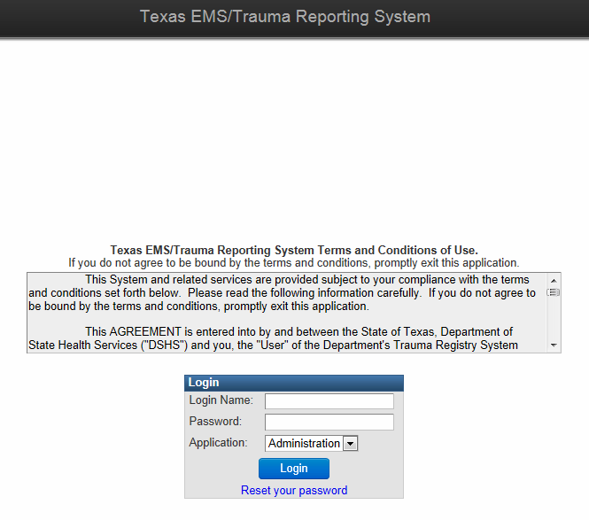
Administration Application
Enter your Login Name and Password.
To access the Administration Application, select Administration (instead of Main) from the Application drop-down menu.

Slide 4
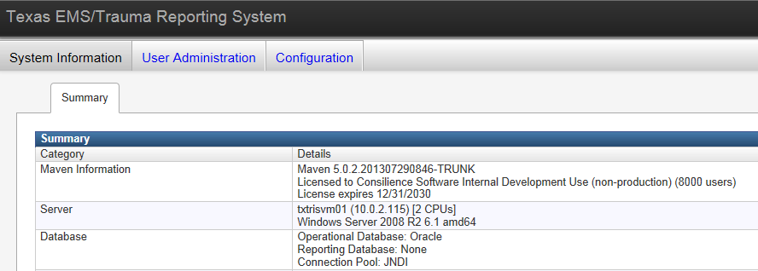
Administration Application
Select User Administration.
Account Managers will be able to view all users, regardless of entity.

Slide 5
Search for a User

Slide 6
Search for a User
User’s account information is accessible under the Users link
Account Managers will be able to view all users, regardless of entity
Even though Account Managers are able to view all users, they may only edit users belonging to their entity

Slide 7
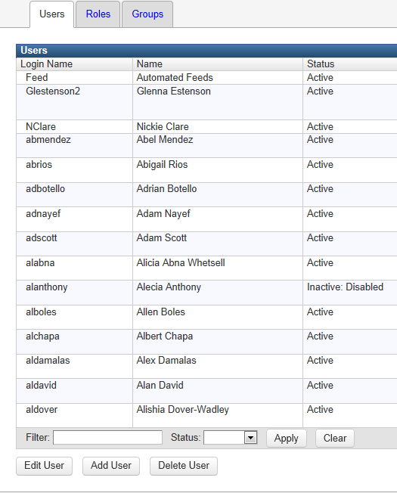
Search for a User
Enter the user’s name* (partial or complete) in the “Filter” field
Select “Apply”
*You may also
search by
login name
(username)
Hospital Tester

Slide 8
Search for a User
Users matching filter criteria will display
The entity name is displayed in the GROUPS column
(1 Test Hospital)
Each entity (e.g. hospital, EMS agency, RAC, third-party agency) has its own “group”

Slide 9
Editing Existing User Information

Slide 10
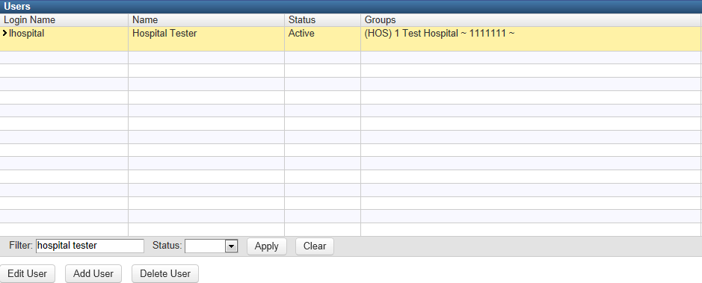
Edit Existing User Information
Search for the user you wish to edit by entering the user’s name in the
Filter field and select Apply.
Select row with user’s information (row will be yellow).
Select “Edit User” button.

Slide 11
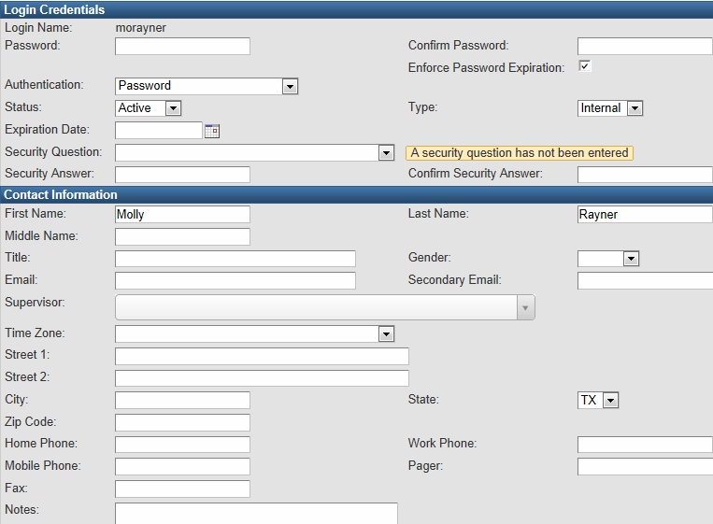
Edit Existing User Information
On the Edit User screen you can reset a password or enter Contact Information for the user.
Please ensure that you include the user’s Email address and at least one Phone Number.

Slide 12
Reset Password

Slide 13
Reset Password
1
2
3
New password fields
Password – enter a new temporary password
Confirm Password – retype new temporary password for verification
“Force Password Change” checkbox
Ensure box is checked
The user will reset the password the next time he/she logs in
Status drop-down menu
Ensure Status drop-down menu is set to “Active”
The user will not be able to login unless the status is set to Active

Slide 14
Security Question/Answer
If you see the message “A security question has not been entered,” ask your user to set up their security question using Edit Profile on the Main side of the application. (Instructions for this are in the Basic Training).
By setting up a security question, this will allow the user to use the Reset Password option located on the Login page.

Slide 15
Create a New User

Slide 16
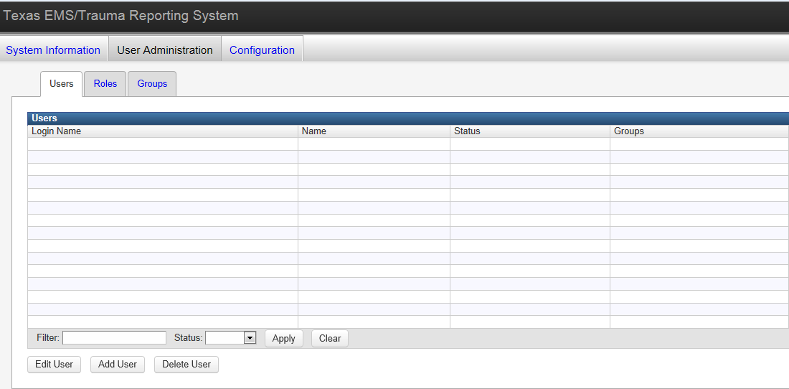
Create a New User
Navigate to the Users link under the User Administration tab
Select “Add User” button

Slide 17
Create a New User
Login Name
Format – first two initials of first name and full last name
Must be entered in all lowercase letters
Example – Registry Tester = retester
Password
8-14 characters in length
One number
One symbol
Force Password Change
Select checkbox
Will force user to reset password next time user logs in

Slide 18
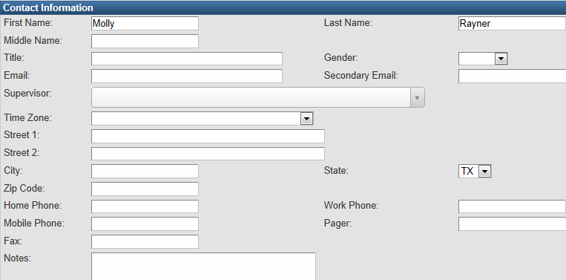
Create a New User
You must include a First and Last Name.
Fill in as much Contact Information as you can, including an Email address and at least one direct Phone Number.

Slide 19
Create a New User
Each user must be assigned two roles:
Entity Records – TRIS User
Patient Records – TRIS User
Click on the Available Role and use the right double arrow to move them into the Selected Roles box.
Select the “Save” button when complete.
Provide the user with the Login Name and Temporary Password.

Slide 20
Adding a User to Your Entity

Slide 21
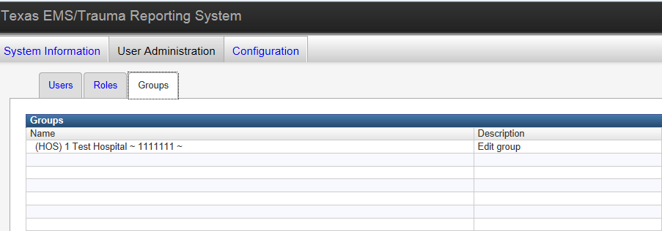
Select Entity (Groups)
Under User Administration, select the Groups tab.
All entities that you are the Account Manager for will automatically display here.

Slide 22
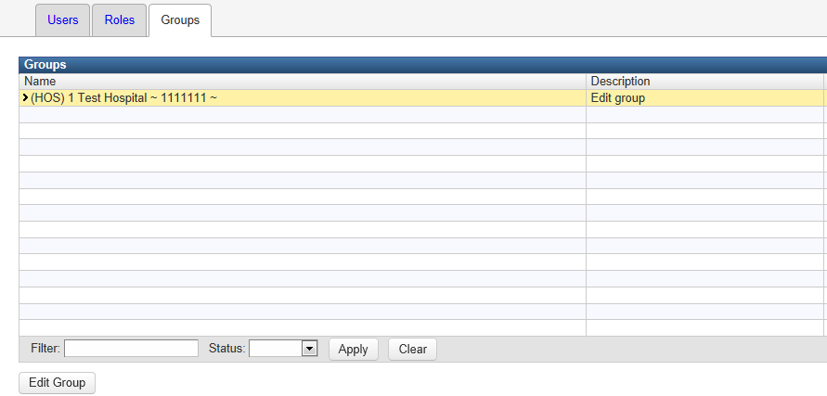
Select Entity (Groups)
Select the Entity that you wish to add a user to by clicking on the row
(row will be yellow).
Select the “Edit Group” button.

Slide 23
Add User as Group Member
Available Users – lists all users in the system (not just your entity users.
Group Members – lists users that have access to your entity that are not Account Managers.
Group Admins – lists entity Account Managers (you should have two if possible).

Slide 24
Add User as Group Member
Find the user you would like to add to your entity’s account in the Available Users section.
Select the user, then use the right double-arrow to move the user from Available Users to Group Members

Slide 25
Add User as Group Member
The user now displays under Group Members.
Select the Save button to finalize your change.
The user is now linked with your entity and may access and/or report records for your entity.

Slide 26
Add User as Account Manager
Find and select the user that you wish to make an Account Manager from either Available Users or Group Members.
Using the double arrows, move the user all the way to the Group Admins box.
If the user was in Available Users, you will move them to Group Members, then to Group Admins.

Slide 27
Add User as Account Manager
The user now displays under Group Members.
Select the Save button to confirm your selection.
The user is now an Account Manager and may perform Administrative functions for your entity.

Slide 28
Removing a User from Your Entity

Slide 29
Remove User from Entity
Check with the user to see if they report for multiple entities.
If the user only reports for your entity, you must make the user Inactive.
If the user reports for multiple entities – DO NOT make the user Inactive.
If you remove the user from your entity (group) before changing the Status to “Inactive,” you will not be able to change the user’s Status.
An active user can still log into the registry, even though they are not associated with any entities, but they are not able to view any records.

Slide 30
Make User Inactive
Search for the user you wish to edit by entering the user’s name in the
Filter field and select Apply.
Select row with user’s information (row will be yellow).
Select “Edit User” button.

Slide 31
Make User Inactive
DO NOT perform this step if the user reports for multiple entities.
Using the Status drop-down menu, change the status from Active to Inactive.
Select Save at the bottom of the screen to confirm the change.

Slide 32
Remove User from Entity (Group)
Under User Administration, select the Groups tab.
Select the Entity that you wish to remove the user from by clicking on the row (row will be yellow).
Select the “Edit Group” button.

Slide 33
Remove User from Entity (Group)
Select the user you wish to remove from the Group Admins or Group Members box.
Using the double arrows, move the user all the way to the Available Users box.
If the user was in Group Admins, you will move them to Group Members, then to Available Users.

Slide 34
Remove User as Group Member
The user now displays under Available Users.
Select the Save button to confirm your selection.
The user is now removed from your entity and can NOT access and/or report your records.

Slide 35
Main Application
Searching for Your Entity
Entity Record Summary
RAC & Other Data Sharing Agreements
Attachments

Slide 36
Searching for Your Entity

Slide 37
Search for Entity
From the Main Dashboard, you can search for your entity by selecting:
Magnifying Glass
Search for an existing record

Slide 38
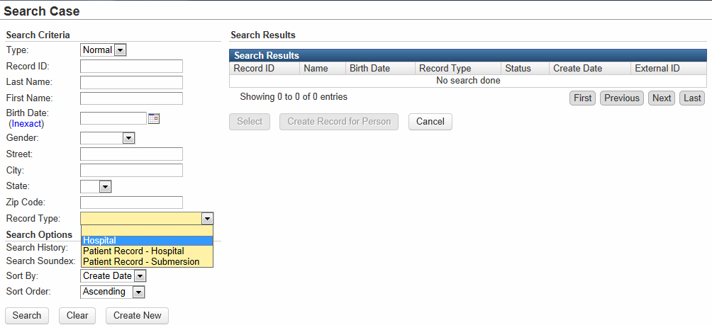
Search for Entity
Select the appropriate entity type from the drop-down menu.
Selecting an entity type will change Last Name/First Name fields to a single Name field.

Slide 39
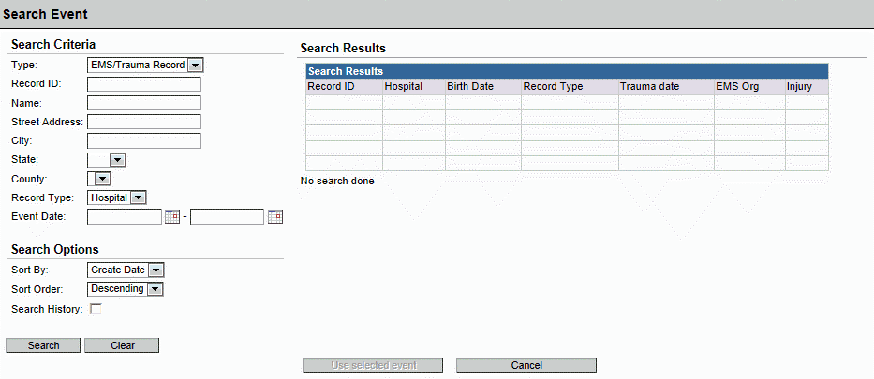
Search for Entity
Select Search to continue.
You do not have to enter any other search criteria.
The search will automatically bring up your entity/entities that you have permission to view.

Slide 40
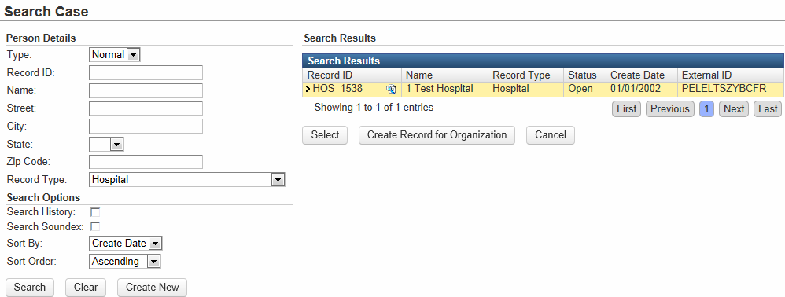
Search for Entity
Select your entity from the Search Results by clicking on the row (row will be yellow once selected).
Press Select to Continue.

Slide 41
Entity Record Summary

Slide 42
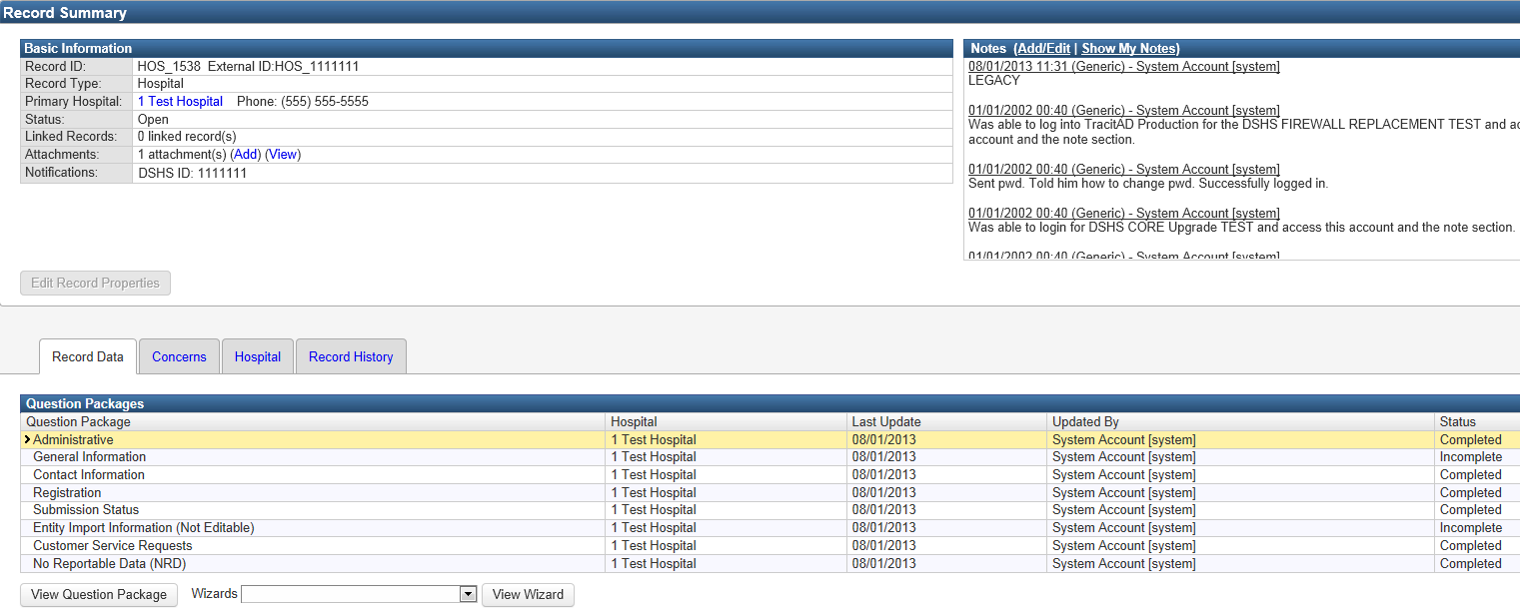
Entity Record Summary
The Record Summary screen is an overview of Entity Record information.
There are three main sections to this screen.
1. Basic Information
2. Notes
3. Question Packages

Slide 43
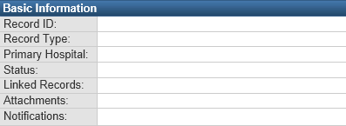
Entity Record Summary
1. Basic Information
Unique ID assigned by the system
Type of event
Hospital Name and Phone Number
Current status of the event
Record linking will be done by DSHS
Attach files (i.e. Business Associate Agreement )
Contains custom information (i.e. DSHS ID)

Slide 44
Entity Record Summary
2. Notes
The notes section is where DSHS can enter any additional comments or information regarding your entity.

Slide 45
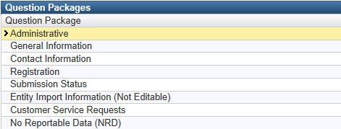
Entity Record Summary
3. Question Packages
Question Packages are groups of questions that share a common theme.
(Manage RAC and Business Associate Agreements)
(Entity Location Info, Mailing Address, Software)etc.
(Main contact for your entity)
(Facility characteristics)
(Overview of record submissions via roster import)
(Entity info imported by DSHS)
(Coming soon)
(Go here to report No Reportable Data)

Slide 46
RAC & Other Business Associate Agreements (BAA)

Slide 47
RAC & Other Business Associate Agreements (BAA)
If your entity wishes your Regional Advisory Council (RAC) to have access to and/or submit data for your entity
If your entity wishes a third-party (e.g. vendor, billing company etc.)a business associate agreement (BAA) must be completed and signed by both parties and attached to the entity’s record

Slide 48
RAC & Other Business Associate Agreements (BAA)
It is the entity’s responsibility to obtain the electronic BAA agreement (a scanned copy with signatures) and attach the electronic file to the entity record in the EMS/Trauma Registry system, as this agreement gives another party access to the private health information of the entity’s patients
All agreements will be reviewed by registry staff before access to data is allowed between parties

Slide 49
Business Associate Agreements (BAA)
The format of the document is decided by the entity
DSHS approval
A signed agreement by someone representing the entity’s administration* (e.g. hospital or EMS administrator, CEO, Medical Director, etc.)
For RACs, vendors, billing companies: either the:
A signed agreement by the RAC Chair or Director, or
A signed agreement by the Vendor or billing company administrator or owner

Slide 50
How the Entity Account Manager Attaches the BAA

Slide 51
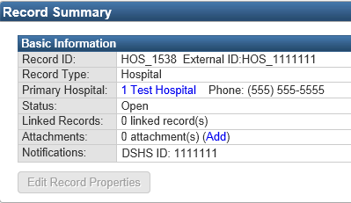
Attachments
Attach the Business Associate Agreement to the Entity record
Select the “Add” link in the Attachments row of the Basic Information block

Slide 52
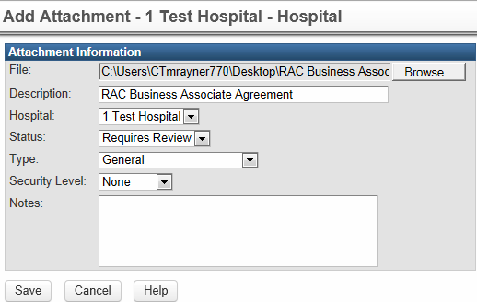
Add Attachment
Attach file by using the Browse button.
Enter a description for the attachment.
Check to ensure the Hospital is correct and the Status is set to Requires Review.
Select the Save button to attach.
For RAC or other business agreements, you must continue to the Administrative Question Package to submit for approval by DSHS.

Slide 53
Administrative Question Package
On the entity’s Record Summary page, open the “Administrative” question package.
This is where you will complete the final steps prior to submitting an agreement for approval.

Slide 54
RAC Agreements
Is there a signed RAC agreement attached to this record?
- Select “Yes” from the drop-down menu.
Enter the Agreement Start Date and End Date.
The RAC field will auto-populate – check to ensure the correct RAC is listed.
Select the Save button to submit for approval.

Slide 55
RAC Agreements
After DSHS review, the DSHS Approved field will either display “Yes” or “No.”
DSHS Reviewer’s name will display and the Date of Review.
If the agreement was not approved, a note will be displayed in “Reason not approved.”

Slide 56
Other Business Agreements
Is there a signed business agreement attached to this record?
- Select “Yes” from the drop-down menu.
Enter the Agreement Start Date and End Date.
Select vendor, billing company, or entity using the search function (select the magnifying glass).
The Entity Number will auto-populate.
Select the Save button to submit for approval.

Slide 57
Other Business Agreements
After DSHS review, the DSHS Approved field will either display “Yes” or “No.”
DSHS Reviewer’s name will display and the Date of Review.
If the agreement was not approved, a note will be displayed in “Reason not approved.”

Slide 58
Manage Attachments
Actions:
View – download the attachment
Edit – attach a new file, update the description, etc.
Delete – remove the attachment
When you are finished managing attachments, select the Dashboard button to return to the entity’s main page

Slide 59
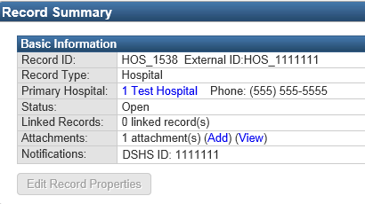
Manage Attachments
The Attachments row now lists “1 attachment(s)”
Select the “Add” link to attach another agreement
Select the “View” link to return to Manage Attachments screen (shown on previous slide)

