Slide 1
Update on COVID-19 Vaccine Administration & Current Status Regarding Mpox
Imelda Garcia, MPH
Associate Commissioner
Laboratory & Infectious Disease Services Division
December 7, 2022

Slide 2
DISCLAIMER
The information presented today is based current preliminary data and on CDC’s recent guidance. Information is subject to change.
December 7, 2022

Slide 3
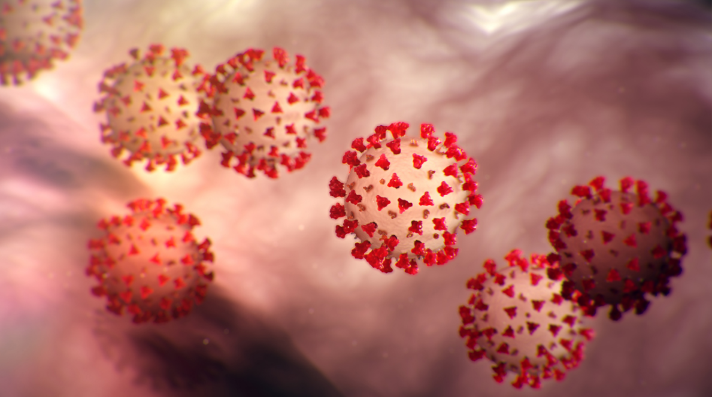
COVID-19 Vaccine Update

Slide 4
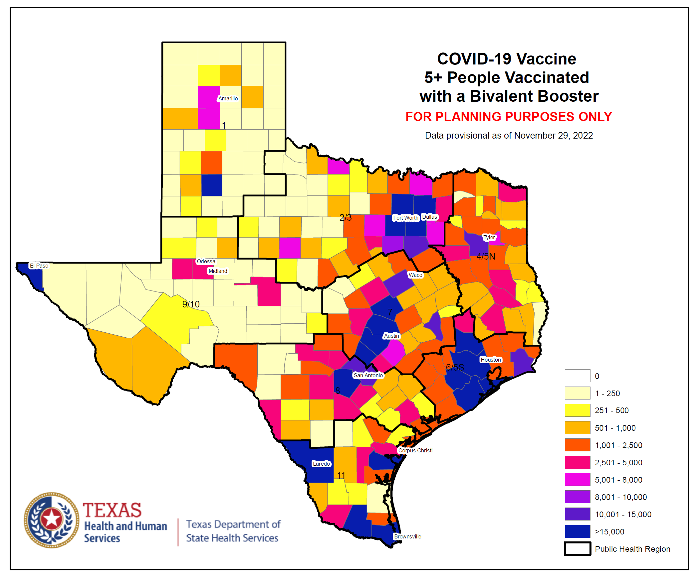
Bivalent COVID-19 Vaccine Booster Doses Administered, Texas (11/29/2022)
Age Group | Population | Number of Bivalent Boosters
5-11 years | 2,898,962 | 26,807 (0.92%)
12-17 years | 2,472,553 | 58,733 (2.3%)
18-49 years | 12,885,909 | 464,574 (3.6%)
50-64 years | 4,975,933 | 500,703 (10%)
65+ years | 3,734,229 | 834,333 (22.3%)
Total | 26,967,586 | 1,885,151 (6.99%)

Slide 5
BIVALENT COVID-19 Vaccines (6 months through 4 years)

Slide 6
BIVALENT COVID-19 Vaccines (6 months through 4 yrs)
The Food and Drug Administration is expected to authorize both Modern and Pfizer bivalent COVID-19 booster vaccines for this age group in the coming days.
This will follow clinical recommendations from Centers of Disease Control and Prevention (CDC).
Providers can then begin vaccinating this age group with the updated bivalent booster based on the clinical recommendations issued by the CDC.

Slide 7
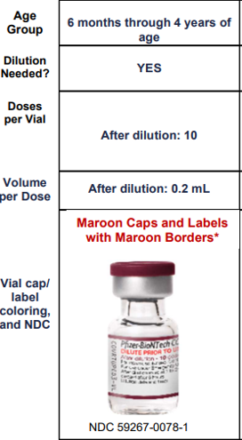
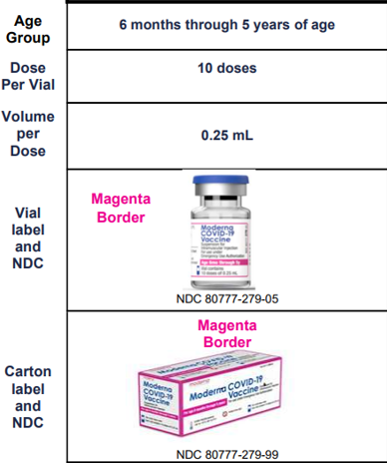
BIVALENT COVID-19 Vaccines for (6 Months through 4 Years)
Pfizer COVID-19 Vaccines
(6mos-4 yrs)
Monovalent Bivalent
Moderna COVID-19 Vaccines
(6mos-5yrs)
Monovalent Bivalent
The same maroon cap vial as the as monovalent with Bivalent printed
Identical dose, dilution, storage, handling, and preparation as the monovalent for this age group
Vial color change to dark pink cap with yellow border
Dose is 10 mcg (0.2 mL)
2 doses per vial
After punctured, discard after 8 hours

Slide 8
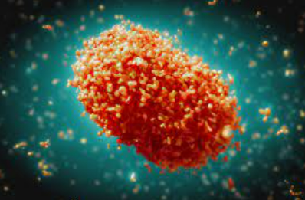
Mpox Update

Slide 9
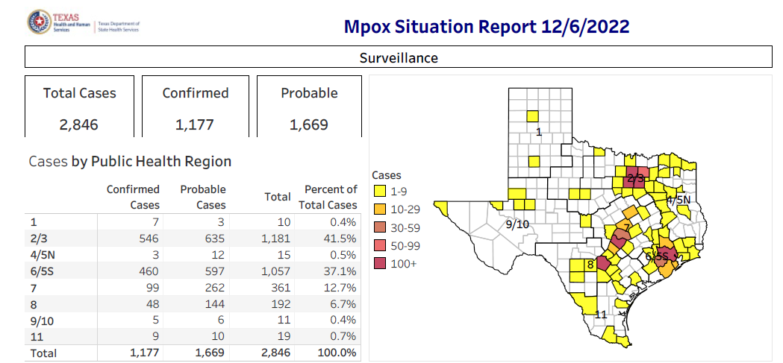

Slide 10
Case Demographics
Age Category | # of Cases | % of Cases
<18 Years | 19 | 0.7%
18-29 Years | 827 | 29.1%
30-39 Years | 1188 | 41.7%
40-49 Years | 540 | 19.0%
50-59 Years | 224 | 7.9%
60+ Years | 48 | 1.7%
Total | 2,846 | 100%
Race | # of Cases | % of Cases
Hispanic | 835 | 29.3%
Asian | 46 | 1.6%
Black | 977 | 34.3%
White | 654 | 23.0%
Other | 128 | 4.5%
Unknown | 206 | 7.2%
Total | 2,846 | 100%
Sex | # of Cases | % of Cases
Male | 2752 | 96.7%
Female | 94 | 3.3%
Total | 2,846 | 100%

Slide 13
As of December 6, 2022, a total of 27,461 People Vaccinated
(44,335 Doses) with JYNNEOS (ImmTrac2 data) in Texas
JYNNEOS Administration (ImmTrac2) by PHR |  |  |  |  | Cases
PHR | One Dose | People Fully Vaccinated | Total Doses Administered | % | Total Cases | %
1 | 130 | 89 | 219 | 0.5% | 10 | 0.4%
2/3 | 7,786 | 4,622 | 12,422 | 28.0% | 1,181 | 41.5%
4/5N | 103 | 63 | 166 | 0.4% | 15 | 0.5%
6/5S | 10,272 | 6,652 | 16,938 | 38.2% | 1,057 | 37.1%
7 | 5,140 | 2,836 | 7,983 | 18.0% | 361 | 12.7%
8 | 1,647 | 1,111 | 2,761 | 6.2% | 192 | 6.7%
9/10 | 530 | 259 | 789 | 1.8% | 11 | 0.4%
11 | 945 | 714 | 1,660 | 3.7% | 19 | 0.7%
Unknown | 908 | 488 | 1,397 | 3.2% | 0 | 0.0%
Total | 27,461 | 16,834 | 44,335 | 100.0% | 2,846 | 100.0%
As of December 6, 2022, there are 9,770 individuals overdue (day 43) for their second dose of JYNNEOS to complete the primary series.

Slide 14
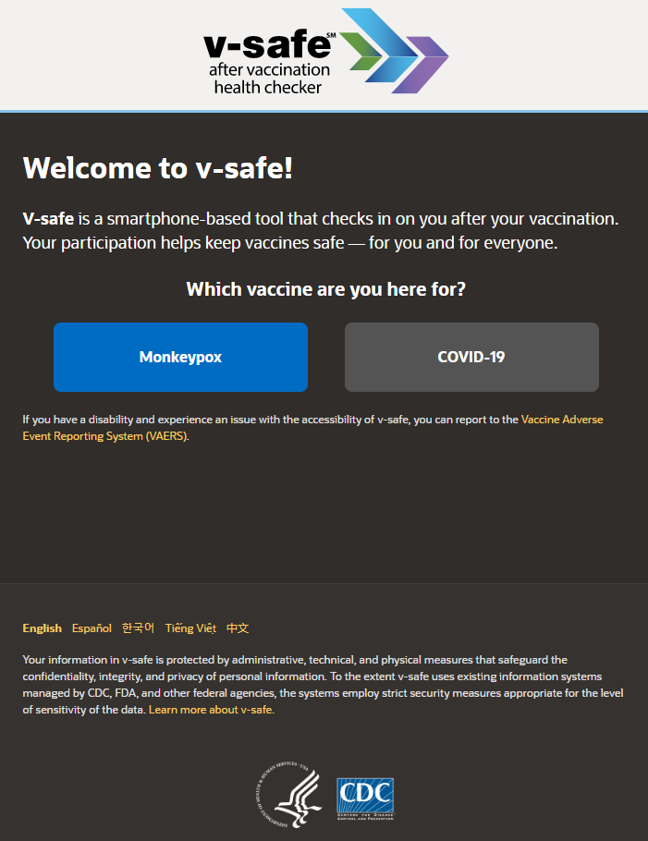
NEW: V-safe after MPOX Vaccination
V-safe is a safety monitoring system that lets you share with CDC how you, or your dependent, feel after getting a MPOX vaccine.
After you enroll, v-safe will send you personalized and confidential health check-ins via text messages and web surveys to ask how you feel, including if you experience any side effects after vaccination.
Completing health check-ins and sharing how you feel, even if you don’t experience side effects after vaccination, helps CDC monitor vaccine safety.
How to Enroll or Access Your V-safe for Monkeypox Vaccine Account | Monkeypox | Poxvirus | CDC
V-safe After Vaccination Health Checker for Monkeypox Vaccine | Monkeypox | Poxvirus | CDC
v-safe (cdc.gov)

Slide 15
DISCLAIMER
The information presented today is based current preliminary data and on CDC’s recent guidance. Information is subject to change.
December 7, 2022

Slide 16
Thank you!

